Slide 1

SQL Task Week II: Student Management System
Designing and implementing a relational database for efficient student data management.

Slide 2







Our Team
Bashir Aminat
Lateefah Abdul-Rahman
Hauwa Dauda Atta
Jimoh AbdulRahman
Damilare
Oluwajuwonlo
Toyyib Olalekan

Slide 3

Project Overview: Building the SMS Database
Our core objective is to design and create a robust relational database for a Student Management System (SMS) using SQL.
This system will efficiently store and manage critical data related to students, courses, instructors, and enrollments.
It will enable key administrative functions, from adding students and assigning courses to generating dynamic reports through SQL queries.

Slide 4

Tools & Datasets
Data Source
Student Management System Dataset.xlsx
Key Tools Utilized
Microsoft SQL Server
SQL Server Management Studio
MySQL
Excel
dbdiagram.io
MySQL Workbench
Chat GPT

Slide 5
Database Schema: Core Tables
1
2
3
Students
Departments
Courses
(StudentID, Name, Gender, DOB, DepartmentID)
(DepartmentID, DepartmentName)
(CourseID, CourseName, DepartmentID)
4
5
Enrollments
Instructors
(EnrollmentID, StudentID, CourseID, EnrollmentDate)
(InstructorID, InstructorName, Gender, DepartmentID, CourseID, HireDate, Email)

Slide 6
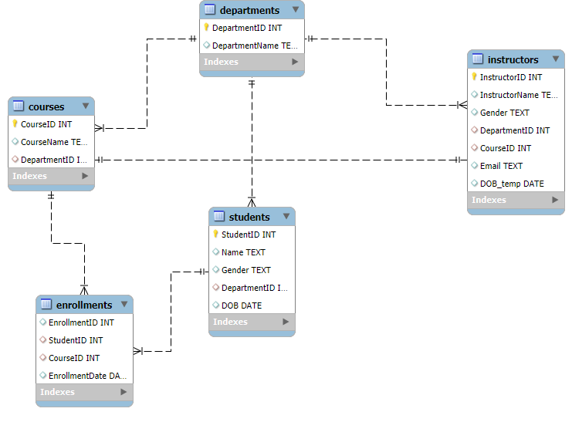
Entity Relationship Diagram (ERD)
Visualizing the interconnectedness of our database tables.

Slide 7




Student & Enrollment Insights
Course Enrollment Counts
How many students are currently enrolled in each course?
Multi-Course Students
Identify students taking multiple courses and list those courses.
Departmental Student Count
Total number of students per department across all courses.

Slide 8
SQL Queries: Student & Enrollment Analysis
Course Enrollment Counts
SELECT
C.CourseName,
COUNT(E.StudentID) AS NumberOfStudents
FROM
Courses C
JOIN
Enrollments E ON C.CourseID = E.CourseID
GROUP BY
C.CourseName
ORDER BY
NumberOfStudents DESC;
Multi-Course Students
SELECT
S.StudentID,
S.Name AS StudentName,
COUNT(DISTINCT E.CourseID) AS NumberOfCourses
FROM
Students S
JOIN
Enrollments E ON S.StudentID = E.StudentID
GROUP BY
S.StudentID, S.Name
HAVING
COUNT(DISTINCT E.CourseID) > 1
ORDER BY
NumberOfCourses DESC, StudentName;
Departmental Student Count
SELECT
D.DepartmentName,
COUNT(DISTINCT E.StudentID) AS TotalStudents
FROM
Departments D
JOIN
Courses C ON D.DepartmentID = C.DepartmentID
JOIN
Enrollments E ON C.CourseID = E.CourseID
GROUP BY
D.DepartmentName
ORDER BY
TotalStudents DESC;

Slide 9

Course & Instructor Analysis
Top Enrollments
Which courses have the highest number of enrollments?
Least Students
Which department has the least number of students?

Slide 10
SQL Queries: Course & Instructor Analysis
Top Enrollments
SELECT
C.CourseName,
COUNT(E.StudentID) AS NumberOfEnrollments
FROM
Courses C
JOIN
Enrollments E ON C.CourseID = E.CourseID
GROUP BY
C.CourseName
ORDER BY
NumberOfEnrollments DESC;
Least Students
SELECT
D.DepartmentName,
COUNT(DISTINCT E.StudentID) AS TotalStudents
FROM
Departments D
JOIN
Courses C ON D.DepartmentID = C.DepartmentID
JOIN
Enrollments E ON C.CourseID = E.CourseID
GROUP BY
D.DepartmentName
ORDER BY
TotalStudents ASC;

Slide 11

Data Integrity & Operational Insights
Unenrolled Students
Are there any students not enrolled in any course?
Average Courses
How many courses does each student take on average?
Gender Distribution
What is the gender distribution of students and instructors?
Gender-Specific Courses
Which course has the highest number of male or female students?

Slide 12
Gender Distribution
SQL Queries: Data Integrity & Operational Insights
-- Student Gender Distribution
SELECT
Gender,
COUNT(StudentID) AS NumberOfStudents
FROM
Students
GROUP BY
Gender;
-- Instructor Gender Distribution
SELECT
Gender,
COUNT(InstructorID) AS NumberOfInstructors
FROM
Instructors
GROUP BY
Gender;
Unenrolled Students
SELECT
S.StudentID,
S.Name AS StudentName
FROM
Students S
LEFT JOIN
Enrollments E ON S.StudentID = E.StudentID
WHERE
E.EnrollmentID IS NULL;
Average Courses
Gender-Specific Courses
SELECT
AVG(CoursesPerStudent.NumberOfCourses) AS AverageCoursesPerStudent
FROM (
SELECT
COUNT(DISTINCT E.CourseID) AS NumberOfCourses
FROM
Enrollments E
GROUP BY
E.StudentID
) AS CoursesPerStudent;
WITH CourseGenderCounts AS (
SELECT
C.CourseName,
S.Gender,
COUNT(S.StudentID) AS StudentCount
FROM
Courses C
JOIN
Enrollments E ON C.CourseID = E.CourseID
JOIN
Students S ON E.StudentID = S.StudentID
GROUP BY
C.CourseName, S.Gender
)
SELECT
CourseName,
Gender,
StudentCount
FROM CourseGenderCounts
WHERE (Gender = 'Male' AND StudentCount = (SELECT MAX(StudentCount) FROM CourseGenderCounts WHERE Gender = 'Male'))
OR (Gender = 'Female' AND StudentCount = (SELECT MAX(StudentCount) FROM CourseGenderCounts WHERE Gender = 'Female'));

Slide 13

Empowering Education Through Data
Our Student Management System provides a robust foundation for informed decision-making and streamlined academic operations.

